Slide 1
Futures Valuation
Chris, Katie and Kevin

Slide 2
The project
Given market data of 8 companies
Choose a pair, and trade only one of them while using the other for correlation purposes
Task:
Design an algorithm to trade the future, using real market data (in a simulated environment)
Notes:
What it is?

Slide 3
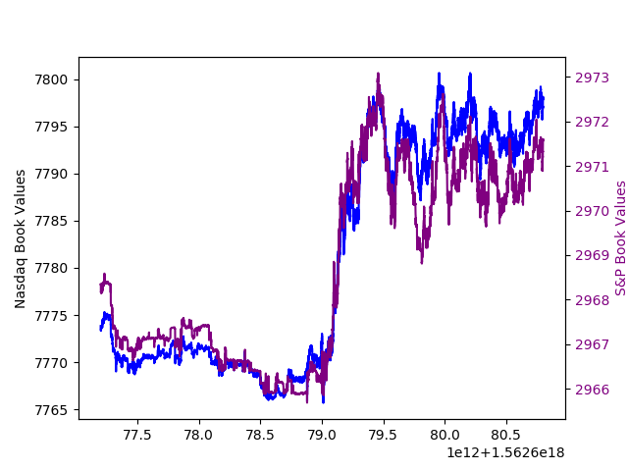
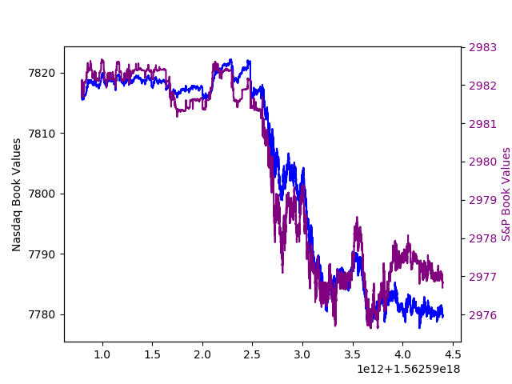
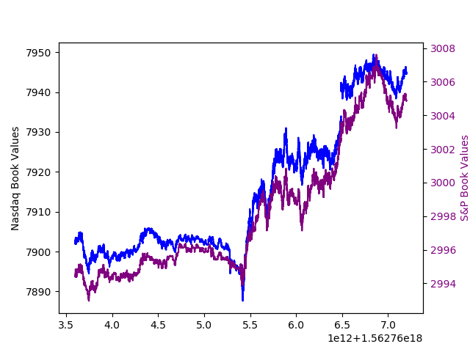
Choosing A Pair:
Ideally looking for:
Correlation
Leading/Lagging Pair
Notes:
Other pairs
General trends of B&D

Slide 4
Trends in B/D
Highly correlated
Tended to be spikes halfway through the day
Afterwards, very volatile
Notes:
US market open

Slide 5
Setting up a Framework
Input Data
Prices
Data Store
Main Algorithms
Valuation
Volumes
PnL
Current Position
Book Depth Valuation
PnL
Position
Time
Buy/sell?
Quote/hit?

Slide 6
Initial approach to Algos
Tried linear regression regression and basic machine learning methods to predict future prices
Issues:
Long run time due to being very calculation heavy
Using data could not get an accurate enough prediction
Often got caught out by market moves, and times of high volatility were also times of massive losses
Notes:
Predicting future prices didn’t help – we have zero reaction time
Trends are more important

Slide 7

Adapting:
Abandoned a lot of the ideas
Much more basic algorithms to evaluate the trend
Instead of quoting, would hit when we believed the price was trending up/down
Much more reactionary
Notes:
Products too volatile – difficult to quote

Slide 8
Storing the Data
Book Depth Valuation:
Bid Volume | Bid Price | Ask Price | Offer Volume
5 | 74.5 | 74.75 | 3
10 | 74.25 | 75.00 | 12
17 | 74.00 | 75.25 | 16

Slide 9
Storing the Data
Book Depth Valuation:
Bid Volume | Bid Price | Ask Price | Offer Volume
5 | 74.5 | 74.75 | 3
10 | 74.25 | 75.00 | 12
17 | 74.00 | 75.25 | 16
x1
X0.2
X0.04

Slide 10
Sampling
Sampling time: 10^5 nanoseconds
Number of samples kept in memory:
Last 100 Book Depth Valuations
Last 100 times
Last 10 PnL figures
Last 10 Delta values
Additional Sampling for Longer trends:
Sampling time: 10^7 nanoseconds
Number of samples kept in memory:
Last 100 Book Depth Valuations (Both B and D)
Notes:
Longer trends ie Dtrend

Slide 11
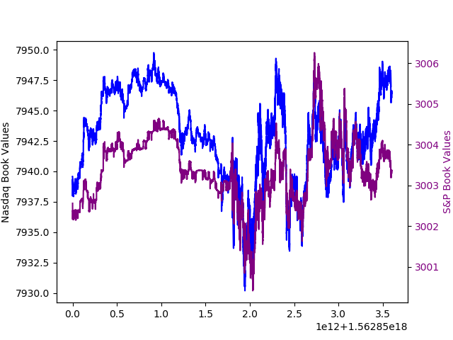
Main algorithm
Exploit high correlation between S&P and NASDAQ
Look for movements in S&P and see if NASDAQ has already moved.
Tracks using standard deviation.
Also tracks trends i.e. if S&P moving up strongly (>1 std as moving average)

Slide 12

Adjustments- DTrend
Small time lag between Nasdaq and S&P
Look for rapid movements in both
Tracks trends using gradient, mean and standard deviation
Stop loss
Notes:
Look for common extreme movements
Use of gradient: find the general trends of B&D
Use of mean and standard deviation: e.g. if most recent valuation – mean of past 20 valuations > 2.5*standard deviation of B & D, buy
A minimum std is set in case the market is being too flat
Stop loss: sell / buy back immediately when trends change directions

Slide 13
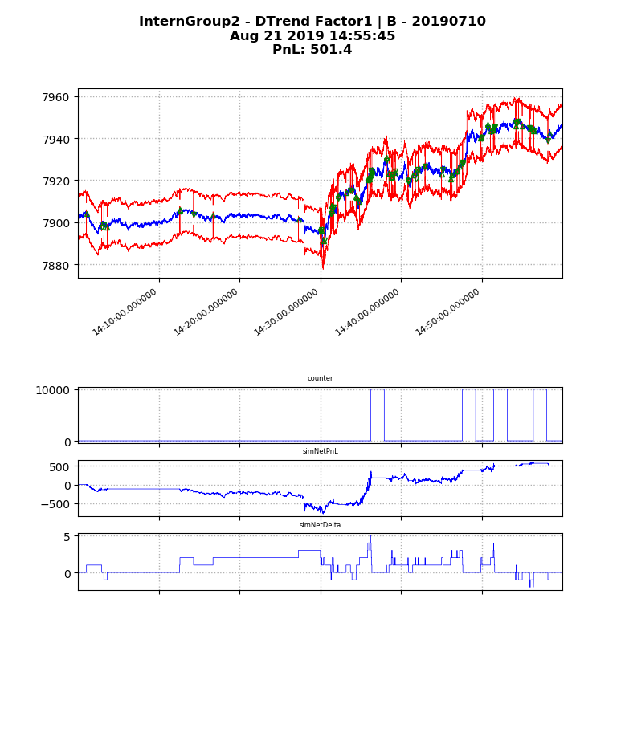
Adjustments – AppleV3, AppleV4
Capture gains/losses
If left too long on a position, things tend to fluctuate wildly, especially after 2:30
Reopens after we have a strong signal to trade
AppleV3 – global, AppleV4 - individual
Notes:
A3 – max gain and max loss for overall PnL (big max loss as we want to make money back when we lose)
A4 – buy back & sell back when we lose too much for individual trades

Slide 14

Testing
Various stages of iteration
5 in sample days (5th,8th,9th,10th,11th)
3 out of sample (12th,15th,16th)
Iterated over the in-sample days changing the algorithm and parameters

Slide 15
Valuation
Main contributor is counter:
Counter locks in a trade: counter will only reset to zero once the delta has
changed
Each one of the above functions adjusts counter.
sell
buy
1
-1
counter

Slide 16
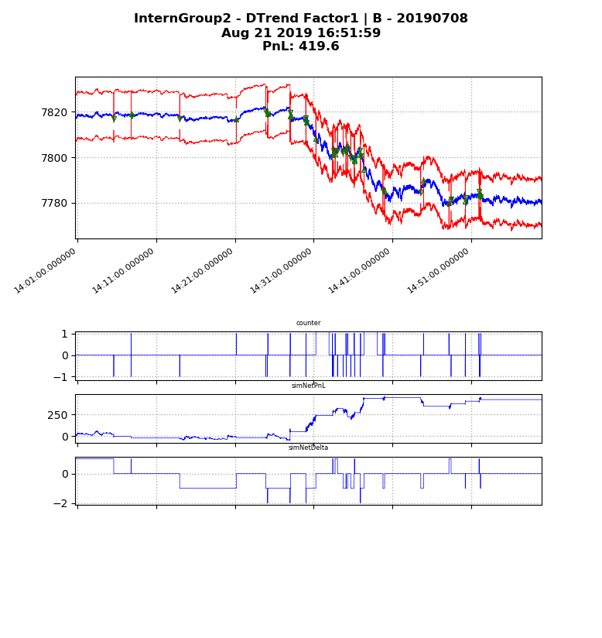
Valuation: Counter

Slide 17

Results
Day | PnL
5th | 899.0
8th | 419.6
9th | 186.2
10th | 501.4
11th | 304.0
12th | 363.1
15th | 316.6
16th | 206.6

Slide 18
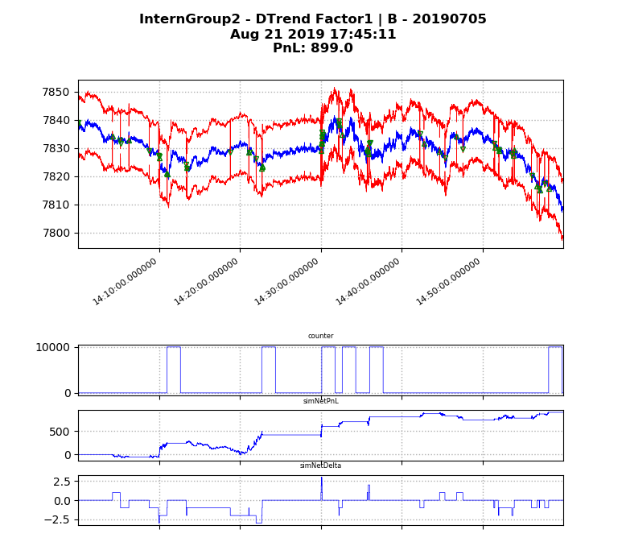
5th of July

Slide 19
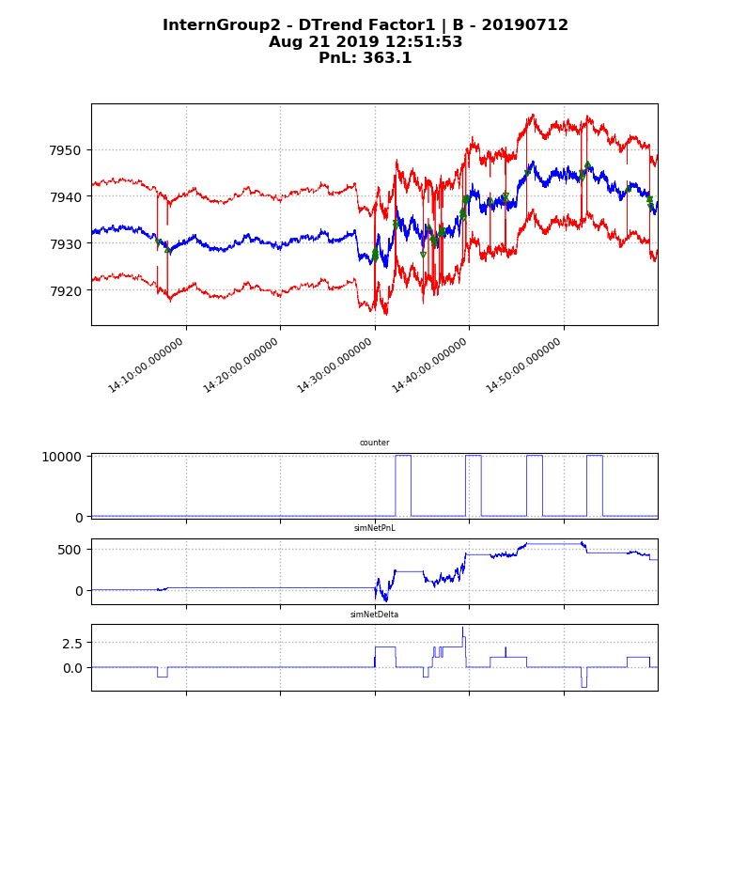
12th of July

Slide 20
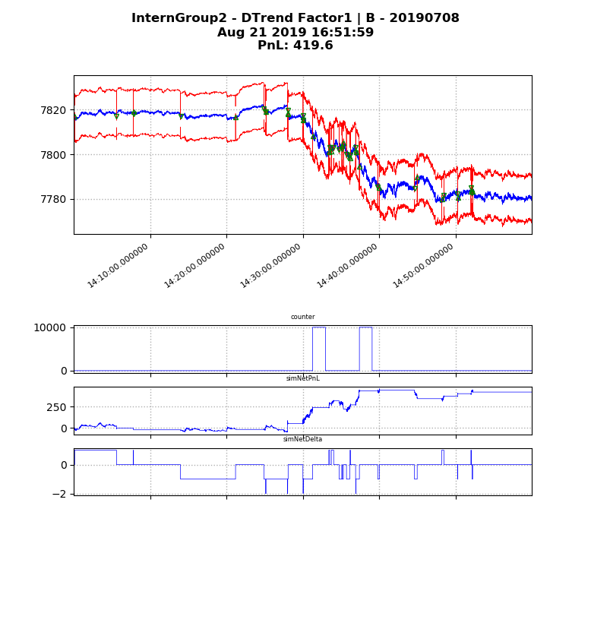
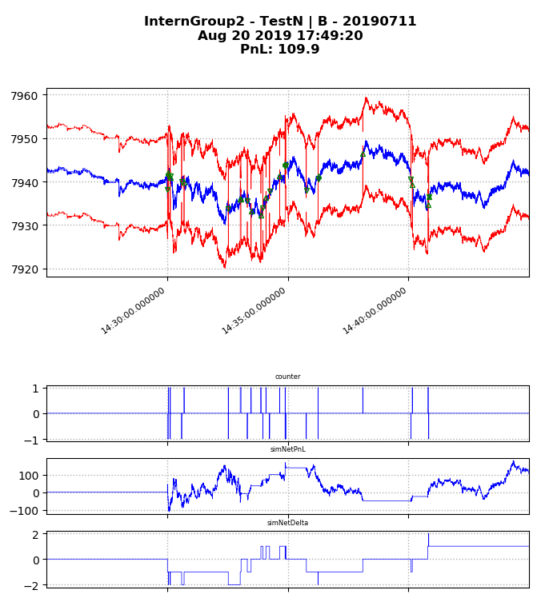
Results: Sample Data
8th
10th
11th

Slide 21
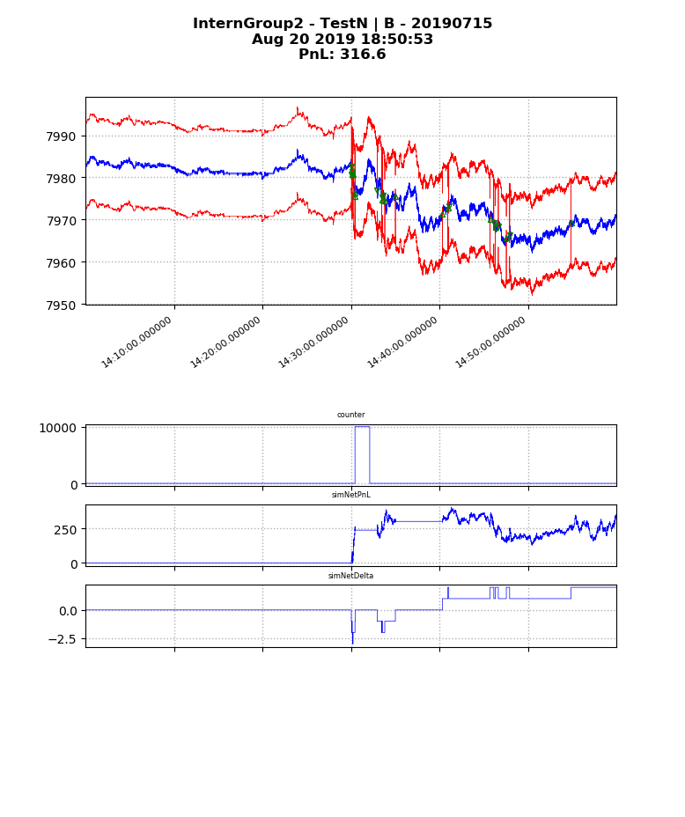
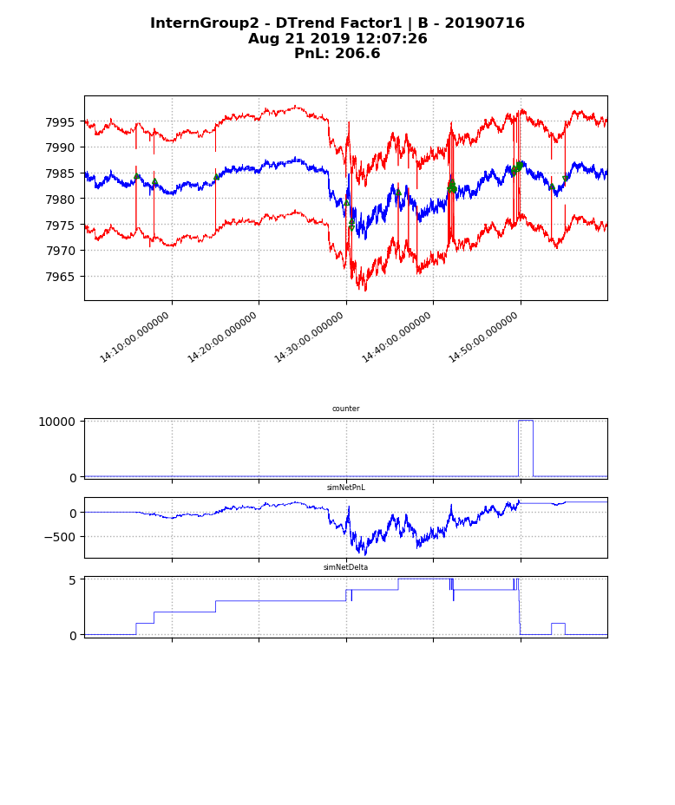
Results: Out of sample
12th
15th
16th

Slide 22
Results
Advantage of the simulation:
Can respond instantly, with no time delay
NASDAQ and S&P very highly correlated, but not reliable which moved first
Looked for large movements in the S&P that had not yet occurred in the NASDAQ
Would almost always react

Slide 23
Unused Functions
StayClosetoZero – puts pressure on the function to sell if we are too long/short
AppleV1, AppleV2 – other alternative ways of locking in PnL
Moving Average – Tracks the moving average, and will trade when moving average is significantly above/below
Mean Reversion – Trade when it spikes and wait for it to un-spike
DLongTrend – Tracks long-term movements of B and D

Slide 24

Possible Improvements
Optimise the factors: were chosen intuitively, and are probably not perfect (e.g. Book Depth Valuation)
Track the volatility, and don’t trade/hold positions in times of high fluctuations
Better Prediction Models

